Slide 1




Extra Session (Discussion)
11th Apr, 2026
Social Networks
Prof. Sudarshan Iyengar
Professor and Head of the Department
Department of Computer Science and Engineering
IIT Ropar
Ayan Paul
PMRF Research Scholar
IIT Kharagpur

Slide 2
Topics on which Week 1 Assignment Questions are based
Social Networks Concepts
Challenges in Social Networks
What can be done with Social Networks
🔹 What is a Social Network?
Nodes = people/entities
Edges = relationships/interactions
Examples: Facebook, collaboration networks, web links
⚠️ Challenges in Social Networks
Scale (millions → billions of nodes)
Noise & incomplete data
Dynamic nature (constantly evolving)
🚀 What Can We Do?
Predict behavior (recommendations)
Detect communities
Spread information (marketing, awareness)

Slide 3
Topics on which Week 2 Assignment Questions are based
Social Network Datasets
Social Network Datasets Types- Ingredient Network, Synonymy Network, Web Graph
Social Network Datasets Analysis
Emergence of Connectedness
🔹 Types of Networks
Ingredient Network 🍲 (food pairings)
Synonymy Network 📖 (words)
Web Graph 🌍 (hyperlinks)
🔍 Analysis Techniques
Degree distribution
Clustering coefficient
Connected components
🔗 Emergence of Connectedness
Giant component forms suddenly
“Everything becomes reachable!”

Slide 4
Topics on which Week 3 Assignment Questions are based
Strength of Week Ties
Granovetter’s Experiment: The Strength of Weak Ties
Neighborhood and Neighborhood Overlap
Structure of weak ties, bridge and local bridge
Structural Holes and Social Capital
Betweenness Measure and Graph Partitioning
👨‍🔬 Mark Granovetter
Weak ties = acquaintances
Strong ties = close friends
👉 Weak ties = job opportunities & new info
🧠 Key Concepts
Neighborhood overlap
Bridges & local bridges
Structural holes → advantage
📏 Betweenness Centrality
Measures control over information flow
Helps detect communities

Slide 5
Topics on which Week 4 Assignment Questions are based
Selection and Social Influence
Interplay between Selection and Social Influence
Homophily - Definition and measurement
Triadic Closure, Foci Closure and Membership Closure
Quantifying the Effect of Triadic Closure
⚖️ Two Forces
Selection → “we choose similar people”
Influence → “we become similar”
❤️ Homophily
“Birds of a feather flock together”
🔺 Closures
Triadic closure → friends of friends connect
Foci closure → same activity
Membership closure → same group

Slide 6
Topics on which Week 5 Assignment Questions are based
Spatial Segregation: An Introduction
Schelling Model and Simulation of the Schelling Model
Structural Balance
Characterizing the structure of balanced networks
Balance Theorem
Forming two coalitions
🏘️ Thomas Schelling Model
Small preferences → large segregation
⚖️ Structural Balance
Friend of friend = friend
Enemy of enemy = friend
🧠 Balance Theorem
Networks split into 2 stable groups

Slide 7
Topics on which Week 6 Assignment Questions are based
The Web Graph
Collecting the Web Graph
Equal Coin Distribution
Random Walk Coin Distribution
Google Page Ranking Using Web Graph
Implementing PageRank Using Points Distribution Method
Implementing PageRank Using Random Walk Method
🔎 Web as a Network
Pages = nodes
Links = edges
💰 PageRank Idea
Important pages get more links
🧮 Methods
Coin distribution
Random walk
👉 “Surfing the web randomly finds important pages!”

Slide 8
Topics on which Week 7 Assignment Questions are based
We Follow. Why do we Follow?
Diffusion in Networks
Modeling Diffusion
Impact of Communities on Diffusion
Cascade and Clusters
Knowledge Thresholds and the Collective Action
📢 Diffusion in Networks
Ideas, trends, viruses spread
🔥 Cascades
Small trigger → massive adoption
🧠 Threshold Model
People adopt only when enough neighbors do

Slide 9
Topics on which Week 8 Assignment Questions are based
Hubs and Authorities
Principle of Repeated Improvement
PageRank Revisited - Conservation and Convergence,
Convergence in Repeated Matrix Multiplication (Pre-requisite 1)
Addition of Two Vectors (Pre-requisite 2)
PageRank as a Matrix Operation
🌟 Concepts
Hubs → point to good pages
Authorities → trusted pages
🔁 Repeated Improvement
Iterative ranking
🧮 PageRank as Matrix
Converges to stable importance

Slide 10
Topics on which Week 9 Assignment Questions are based
Introduction to Power Law
Why do Normal Distributions Appear?
Power Law emerges in WWW graphs
Rich Get Richer Phenomenon
Rich-getting-richer Phenomenon (Barabasi-Albert Model)
Random Graph (Erdos- Renyi Model)
Forced Versus Random Removal of Nodes (Attack Survivability)
⚖️ Normal vs Power Law
Normal → average behavior
Power law → few big, many small
👨‍🔬 Albert-László Barabási Model
Preferential attachment
👉 “Rich get richer!”
💥 Network Robustness
Random removal → safe
Target hubs → collapse

Slide 11
Topics on which Week 10 Assignment Questions are based
Rich Get Richer - A Possible Reason
Rich Get Richer - The Long Tail
Epidemics- An Introduction
Simple Branching Process for Modeling Epidemics
Reproductive number
SIR and SIS spreading models
Percolation model
🔬 Spread Models
Branching process
R₀ (reproduction number)
🧪 Models
SIR → recovered immunity
SIS → reinfection
🌐 Percolation
When spread becomes unstoppable

Slide 12
Topics on which Week 11 Assignment Questions are based
Small World Effect - An Introduction
Milgram's Experiment
The Reason
The Generative Model
Decentralized Search
🧪 Stanley Milgram Experiment
“Six degrees of separation”
🤔 Why It Works?
Short paths exist in large networks
🔍 Decentralized Search
People find paths using local info

Slide 13
Topics on which Week 12 Assignment Questions are based
PseudoCores : Introduction
How to be Viral
Who are the right key nodes?
Finding the right key nodes (the core)
🎯 Key Idea
Not all nodes are equal
🔥 Going Viral
Needs the right nodes, not just many
🧠 Core Nodes
Identified using k-shell decomposition
👉 “Influencers are structurally central, not just popular!”

Slide 14
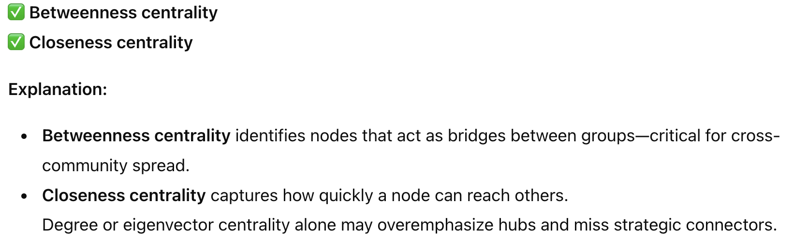
QUESTION 1
Which measures could help identify the key spreaders?
Closeness centrality
Eigenvector centrality
Degree centrality only
Betweenness centrality
SOLUTION 1
CORRECT ANSWER 1
a), d)

Slide 15
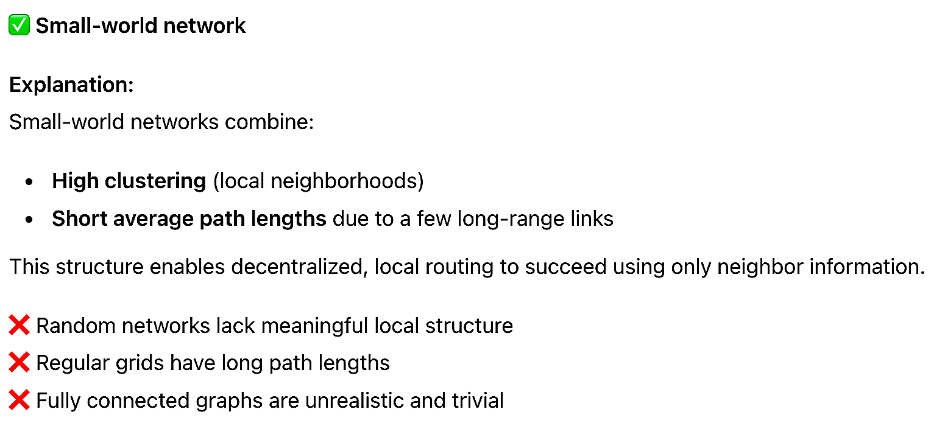
QUESTION 2
In a social network, which topology supports efficient local search?
Random network
Regular grid
Small-world network
Fully connected graph
SOLUTION 2
CORRECT ANSWER 2
c)

Slide 16
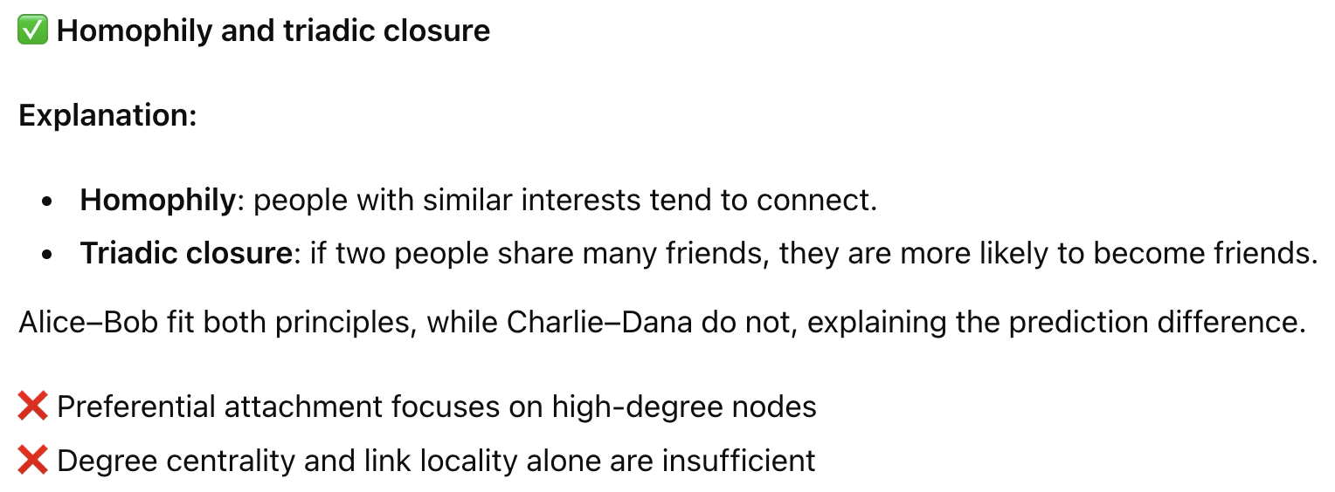
QUESTION 3
Which principle is the algorithm likely using?
Link locality
Homophily and triadic closure
Preferential attachment
Degree centrality
SOLUTION 3
CORRECT ANSWER 3
b)

Slide 17
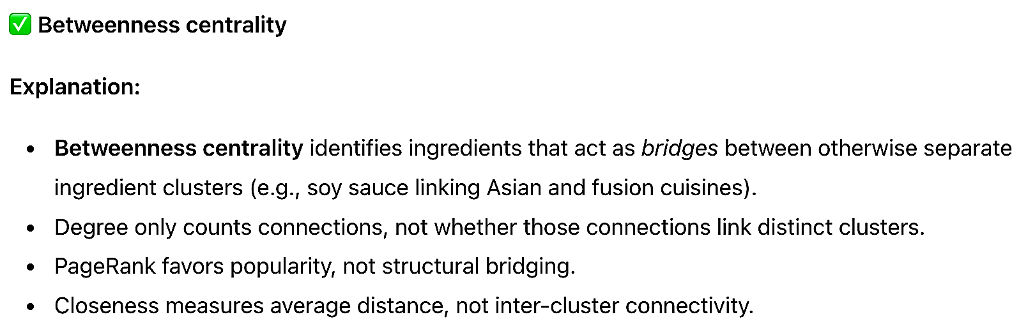
QUESTION 4
If the network is unweighted and undirected, which metric would best indicate an ingredient that connects various ingredient clusters?
Degree centrality
Betweenness centrality
PageRank
Closeness centrality
SOLUTION 4
.
CORRECT ANSWER 4
b)

Slide 18
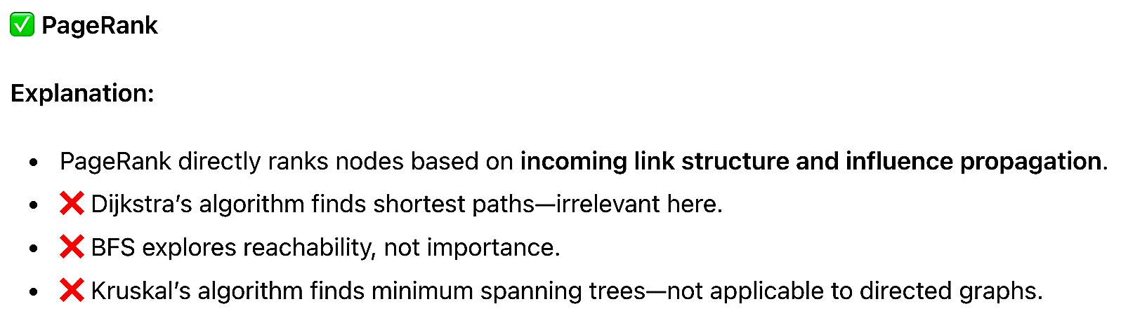
QUESTION 5
Which graph algorithm is most appropriate to identify top influencers in the web graph?
Dijkstra’s algorithm
PageRank
BFS
Kruskal’s algorithm
SOLUTION 5
CORRECT ANSWER 5
b)

Slide 19
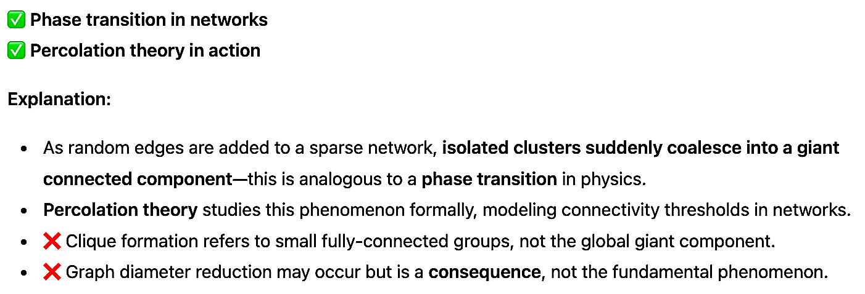
QUESTION 6
The sudden emergence of a giant connected component is an example of:
Phase transition in networks
Percolation theory in action
Clique formation
Graph diameter reduction
SOLUTION 6
CORRECT ANSWER 25
a), b)

Slide 20
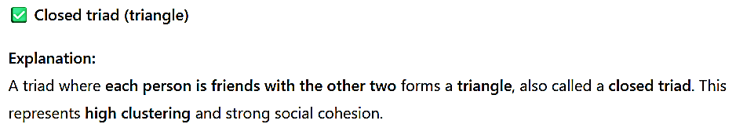
QUESTION 7
A friendship triad where each person is friends with the other two is called a:
Closed triad (triangle)
Structural hole
Local bridge
Open triad
SOLUTION 7
CORRECT ANSWER 7
a)

Slide 21
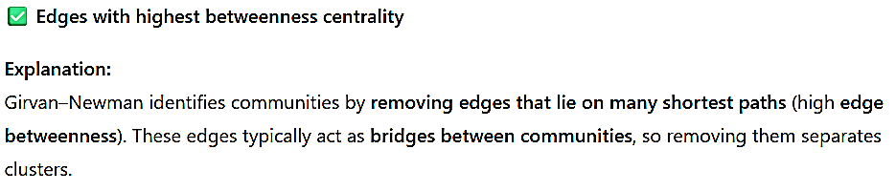
QUESTION 8
In the Girvan–Newman community detection method, what is removed first to reveal communities?
Nodes with highest degree
Edges with highest betweenness centrality
Random edges until clusters form
Edges within dense subgroups
SOLUTION 8
CORRECT ANSWER 8
b)

Slide 22
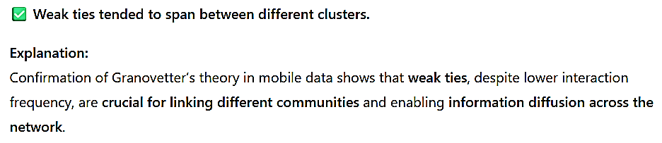
QUESTION 9
Researchers found that confirming Granovetter’s theory in mobile data indicates which of the following about weak ties in this network?
Weak ties were associated with high embeddedness.
Weak ties tended to span between different clusters.
Strong ties were never present.
Weak ties had no role in information diffusion.
SOLUTION 9
CORRECT ANSWER 9
b)

Slide 23
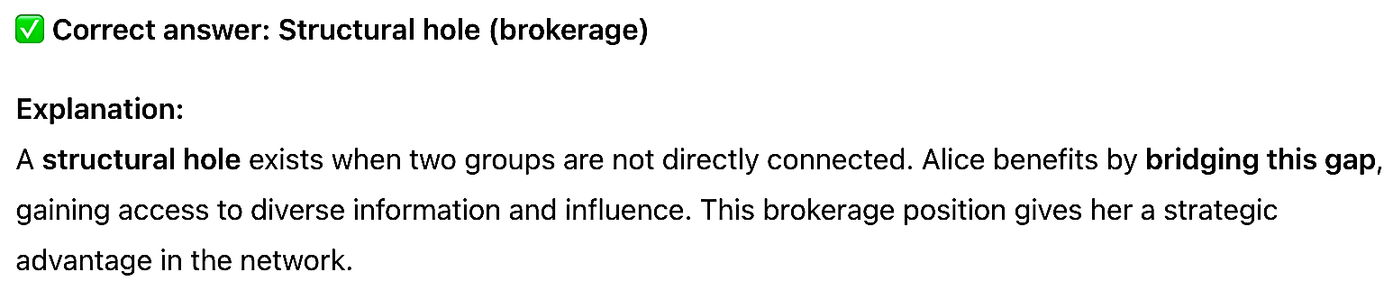
QUESTION 10
Alice acts as a liaison between the marketing and engineering teams, which are otherwise not directly connected. What network concept describes Alice’s advantage in this position?
Clique formation
Community detection
Structural hole (brokerage)
Triadic closure
SOLUTION 10
CORRECT ANSWER 10
c)

Slide 24
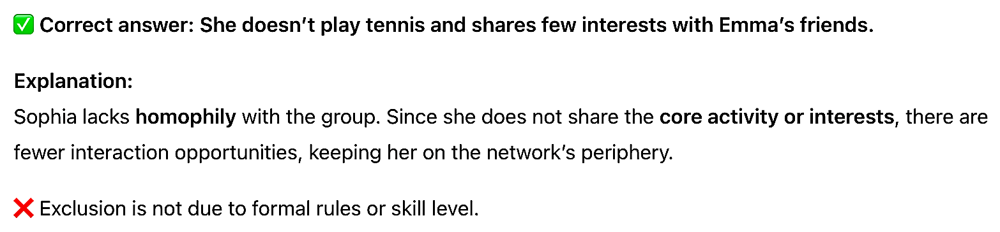
QUESTION 11
Sophia remains on the fringe of the tennis group mainly because:
She attends different events at the campus, unrelated to Emma’s group.
She doesn’t play tennis and shares few interests with Emma’s friends.
She was never formally introduced by the group’s leader.
She isn’t good at sports and is therefore excluded.
SOLUTION 11
CORRECT ANSWER 11
b)

Slide 25
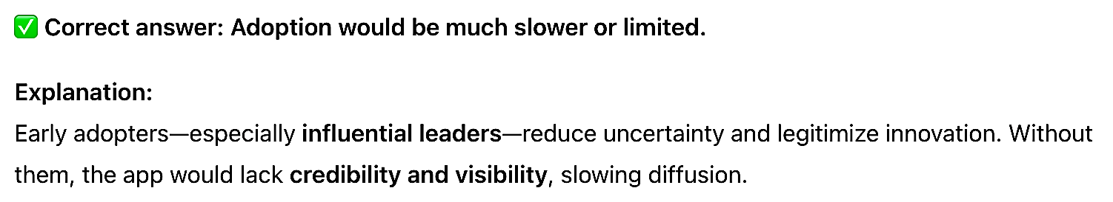
QUESTION 12
If the initial influencers (e.g., team leaders) had not adopted the app early on, what would likely happen?
Adoption would proceed at the same rate regardless.
Adoption would be much slower or limited.
More people would adopt out of curiosity.
The tool would automatically install for everyone
SOLUTION 12
CORRECT ANSWER 12
b)

Slide 26
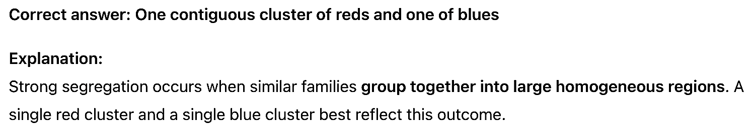
QUESTION 13
Which of these configurations represents strong segregation (given a high threshold)?
Red and blue homes alternating regularly
One contiguous cluster of reds and one of blues
A checkerboard of red/blue
A random mix of reds and blues.
SOLUTION 13
CORRECT ANSWER 13
b)

Slide 27
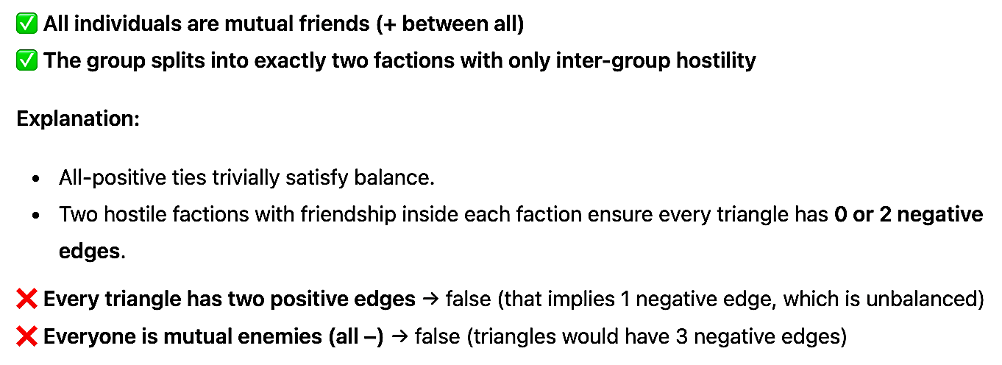
QUESTION 14
Which global outcomes reflect a structurally balanced network? (Select all.)
All individuals are mutual friends (+ between all)
The group splits into exactly two factions with only inter-group hostility
Every triangle in the network has two positive edges
Everyone is mutual enemies (all –)
SOLUTION 18
CORRECT ANSWER 14
a), b)

Slide 28
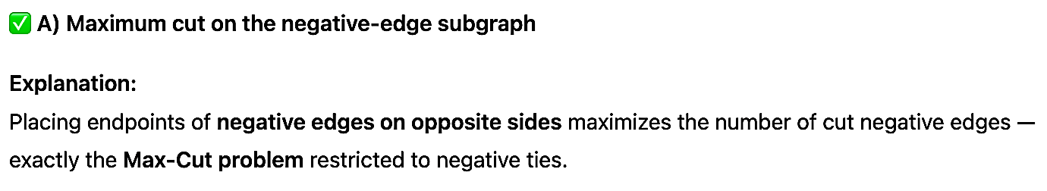
QUESTION 15
Splitting nodes to maximize separation of negative ties is equivalent to which classical problem?
Maximum cut on the negative-edge subgraph
Minimum spanning tree
Clique cover
Hamiltonian cycle.
SOLUTION 15
CORRECT ANSWER 15
a)

Slide 29
QUESTION 16
If 10 influence points are initially given to each user equally, and each user distributes their points equally to the users they follow, how many points does D receive after one round of distribution?
1
2
2.5
3
SOLUTION 16
Each user distributes their points equally among the users they follow. The number of points shared with each followed user depends on the user's "out-degree" (the number of people they follow).
A follows B and C: Out-degree = 2.
A gives 2 / 2 = 1 point to B and 1 point to C.
B follows C and D: Out-degree = 2.
B gives 2 / 2 = 1 point to C and 1 point to D.
C follows D and E: Out-degree = 2.
C gives 2 / 2 = 1 point to D and 1 point to E.
D follows E: Out-degree = 1.
D gives 2 / 1 = 2 points to E.
E follows A: Out-degree = 1.
E gives 2 / 1 = 2 points to A.
There are 5 users: A, B, C, D, and E.
The problem states that 10 influence points are initially given to each user equally.
Total points = 10.
Since they are given to the top 5 users equally, each user starts with 10 / 5 = 2 points.
Initial Points (P₀): A=2, B=2, C=2, D=2, E=2.
User D receives points from any user who follows them. Based on the relationships above:
B follows D.
C follows D.
After one round of distribution, the points each user receives (and thus their new totals, as they distributed all initial points) are:
A receives from E: 2 points.
B receives from A: 1 point.
C receives from A and B: 1 + 1 = 2 points.
D receives from B and C: 1 + 1 = 2 points.
E receives from C and D: 1 + 2 = 3 points.
Total points = 2 + 1 + 2 + 2 + 3 = 10. The sum remains consistent.
Summing the points sent to D:
Points from B to D: 1 point.
Points from C to D: 1 point.
Total points received by D = 1 + 1 = 2 points.
CORRECT ANSWER 16
b)

Slide 30
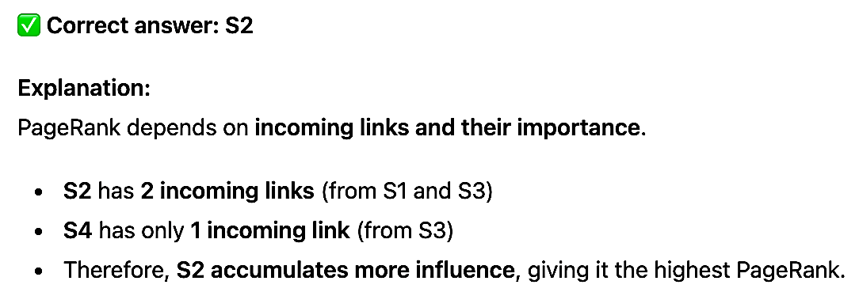
QUESTION 17
S2 is linked by both S1 and S3. S4 is linked only by S3. If all links are equal, which bus
stop is likely to have the highest PageRank?
S1
S2
S3
S4.
SOLUTION 17
CORRECT ANSWER 17
b)

Slide 31
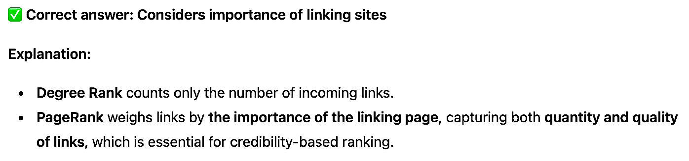
QUESTION 18
Why is PageRank preferred over Degree Rank for ranking websites?
Considers importance of linking sites
Faster to compute
Uses less memory
Handles dangling nodes better.
SOLUTION 18
CORRECT ANSWER 18
a)

Slide 32
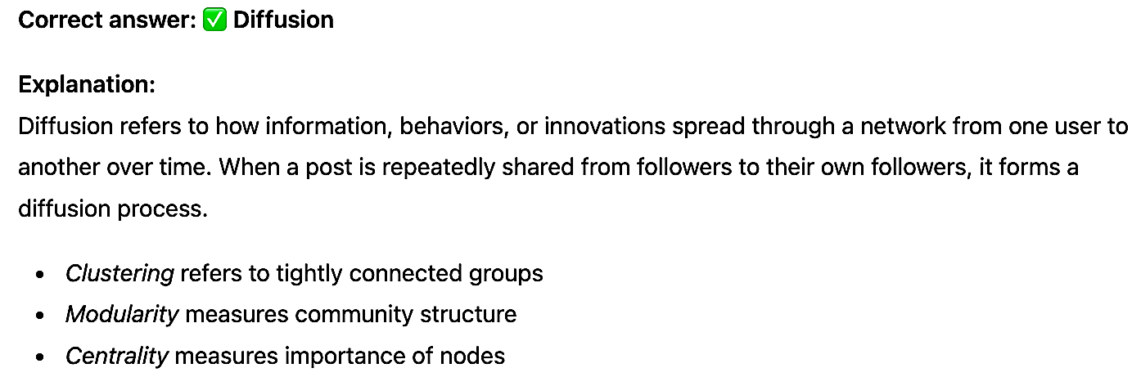
QUESTION 19
What term describes the process where a post is shared by users to their followers, creating a chain of sharing?
Clustering
Diffusion
Modularity
Centrality
SOLUTION 19
CORRECT ANSWER 19
b)

Slide 33
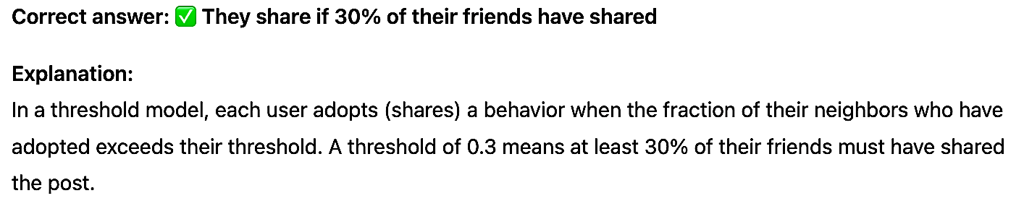
QUESTION 20
If a user’s threshold for sharing a post is 0.3, what does this mean in a threshold model?
They share if 30% of their friends have shared
They share if 3 friends have shared
They share with 0.3 probability
They share if 3 influencers have shared.
SOLUTION 20
CORRECT ANSWER 20
a)

Slide 34
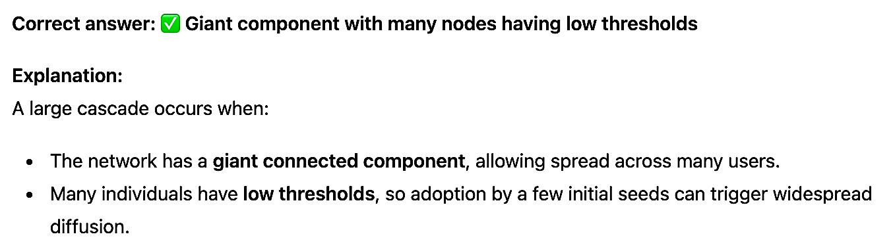
QUESTION 21
What condition is needed for a large EV adoption cascade from a small seed set?
Seed set includes all influencers
Network is fully connected
Giant component with many nodes having low thresholds
All nodes have the same threshold.
SOLUTION 21
CORRECT ANSWER 21
c)

Slide 35
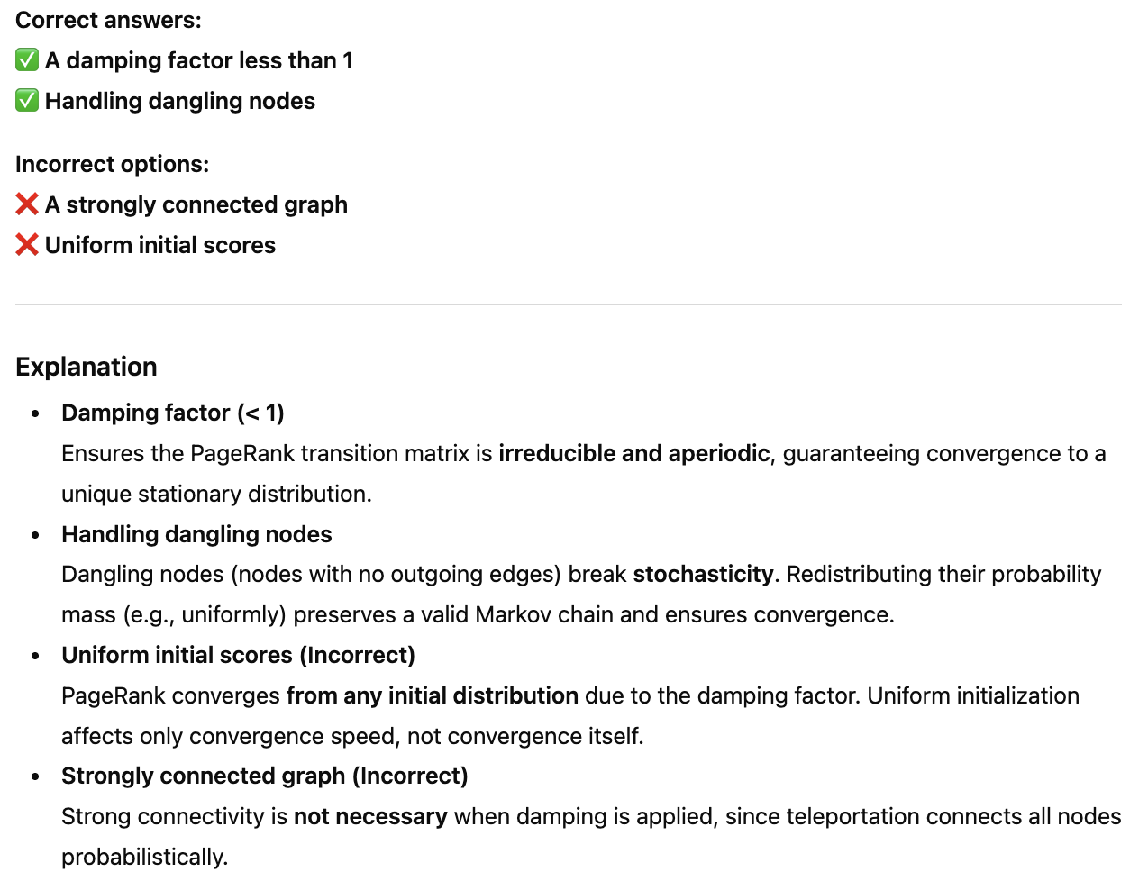
QUESTION 22
In applying PageRank to a social media graph, which ensure convergence? (Select all that apply)
A damping factor less than 1
A strongly connected graph
Handling dangling nodes
Uniform initial scores
SOLUTION 22
CORRECT ANSWER 22
a), c)

Slide 36
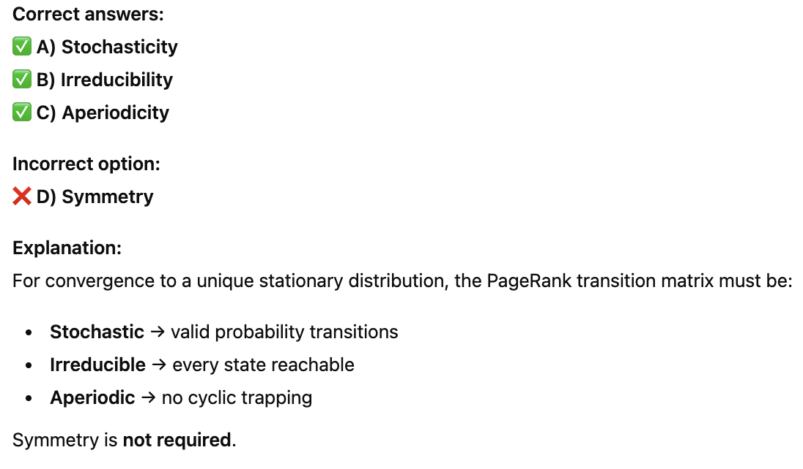
QUESTION 23
Which matrix properties are critical for PageRank convergence? (Select all that apply)
A) Stochasticity
B) Irreducibility
C) Aperiodicity
D) Symmetry.
SOLUTION 10
CORRECT ANSWER 23
a), b), c)

Slide 37
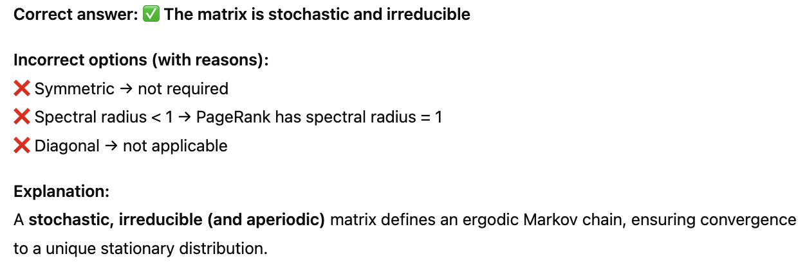
QUESTION 24
Why does repeated matrix multiplication converge in PageRank?
The matrix is symmetric
The spectral radius is less than 1
The matrix is stochastic and irreducible
The matrix is diagonal.
SOLUTION 24
CORRECT ANSWER 24
c)

Slide 38
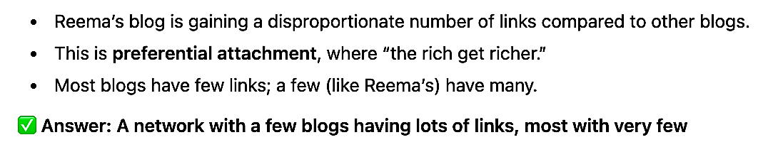
QUESTION 25
What kind of network structure is most likely forming as Reema’s blog gains more backlinks?
A symmetric tree where each node has similar number of links
A centralized star where one node controls all connections
A network with a few blogs having lots of links, most with very few
A chain where each blog links only to the next in time
SOLUTION 25
CORRECT ANSWER 25
c)

Slide 39
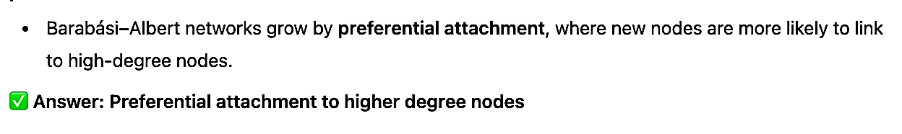
QUESTION 26
If we model the growth of Friendbook using the Barabási–Albert model, what feature must be present in the network?
Equal probability of linking to any user
Preferential attachment to higher degree nodes
Random triadic closure
Negative ties
SOLUTION 26
CORRECT ANSWER 26
b)

Slide 40
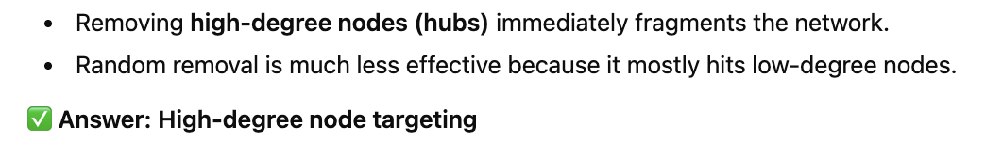
QUESTION 27
Which removal strategy would cause the most damage to a scale-free network?
Random removal of leaf nodes
Random node removal
High-degree node targeting
Removal based on age
SOLUTION 27
CORRECT ANSWER 27
c)

Slide 41
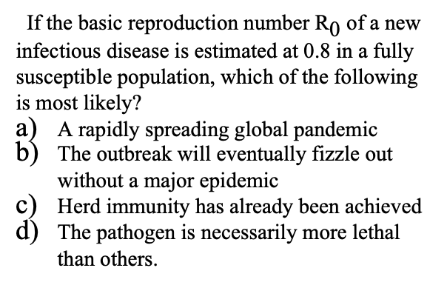
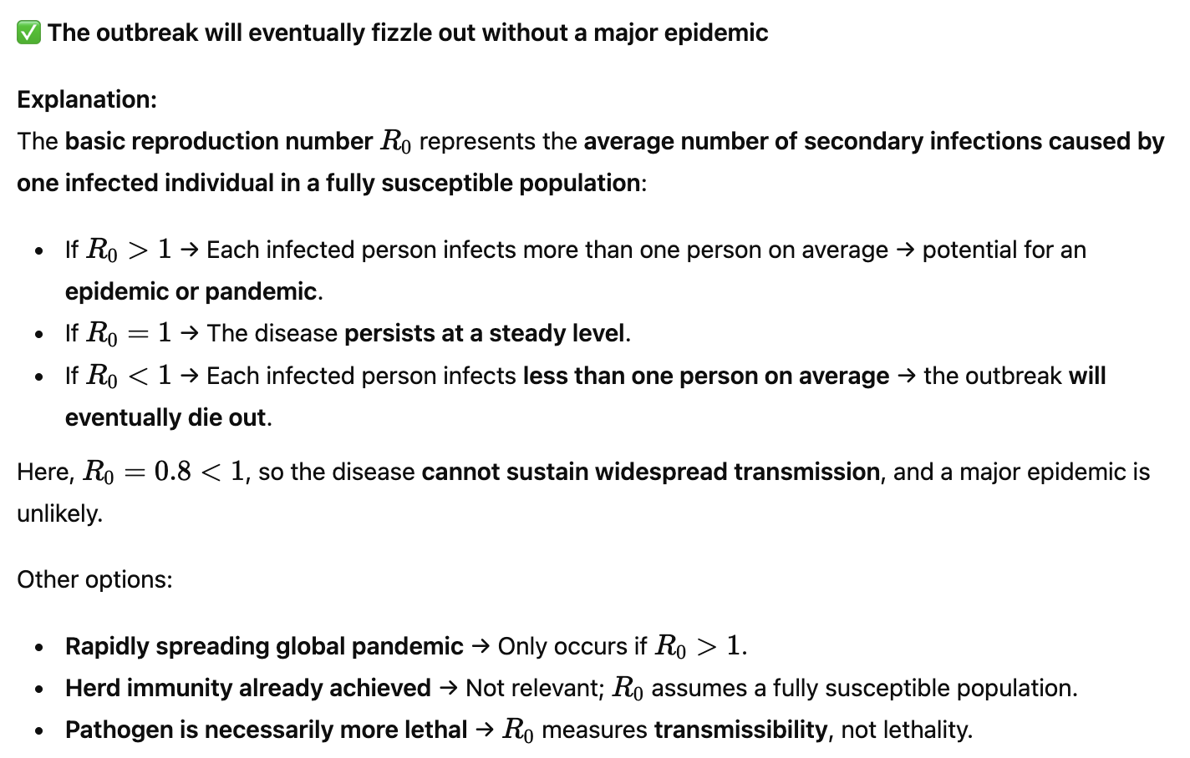
QUESTION 28
SOLUTION 28
CORRECT ANSWER 28
b)

Slide 42
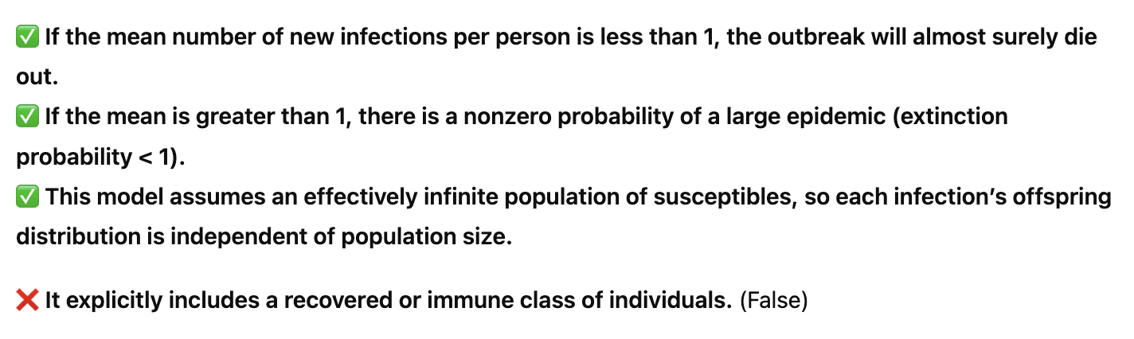
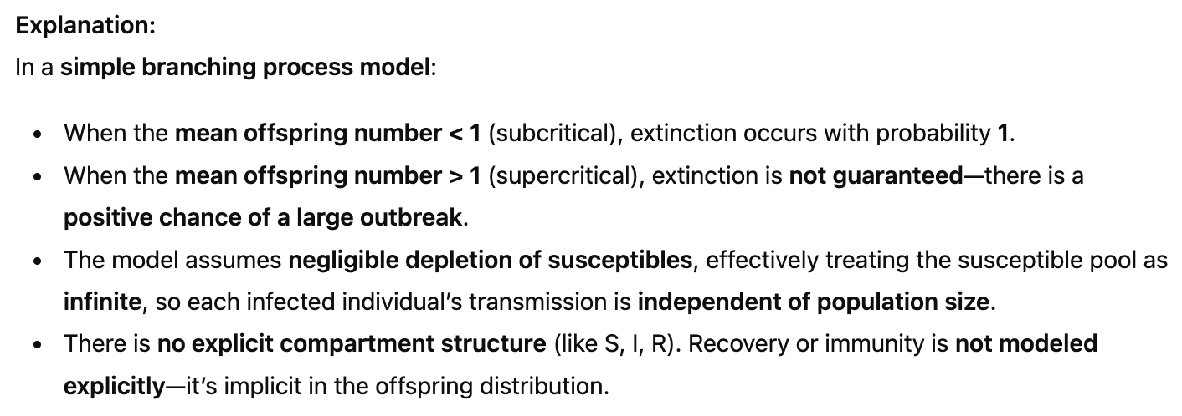
QUESTION 29
In the context of a simple branching process model, which statements are true? (Select all that apply.)
If the mean number of new infections per person is less than 1, the outbreak will almost surely die out.
If the mean is greater than 1, there is a nonzero probability of a large epidemic (extinction probability < 1).
This model assumes an effectively infinite population of susceptibles, so each infection’s offspring distribution is independent of population size.
It explicitly includes a recovered or immune class of individuals.
SOLUTION 29
CORRECT ANSWER 29
a), b), c)

Slide 43
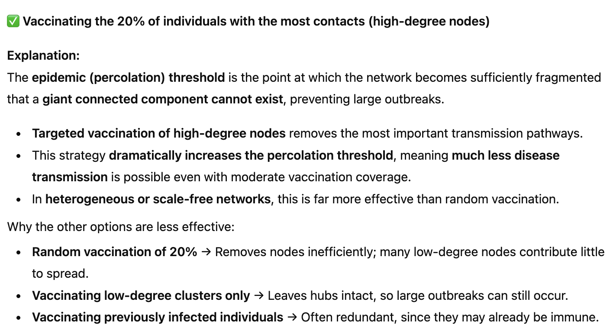
QUESTION 30
Which vaccination strategy generally leads to a higher epidemic (percolation) threshold on a network?
Random vaccination of 20% of the population
Vaccinating the 20% of individuals with the most contacts (high-degree nodes)
Vaccinating all individuals in low-degree clusters only
Vaccinating only individuals who have previously been infected.
SOLUTION 15
CORRECT ANSWER 30
b)

Slide 44
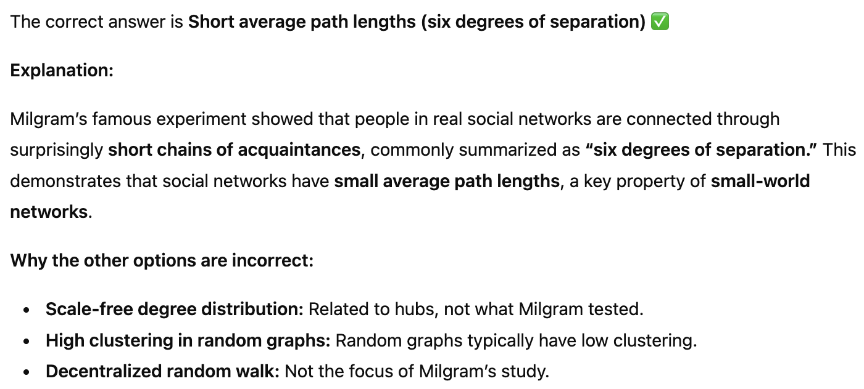
QUESTION 31
What phenomenon does Milgram’s experiment demonstrate in real social networks?
Scale-free degree distribution
Short average path lengths (six degrees of separation)
High clustering in random graphs
Decentralized random walk.
SOLUTION 31
CORRECT ANSWER 31
b)

Slide 45
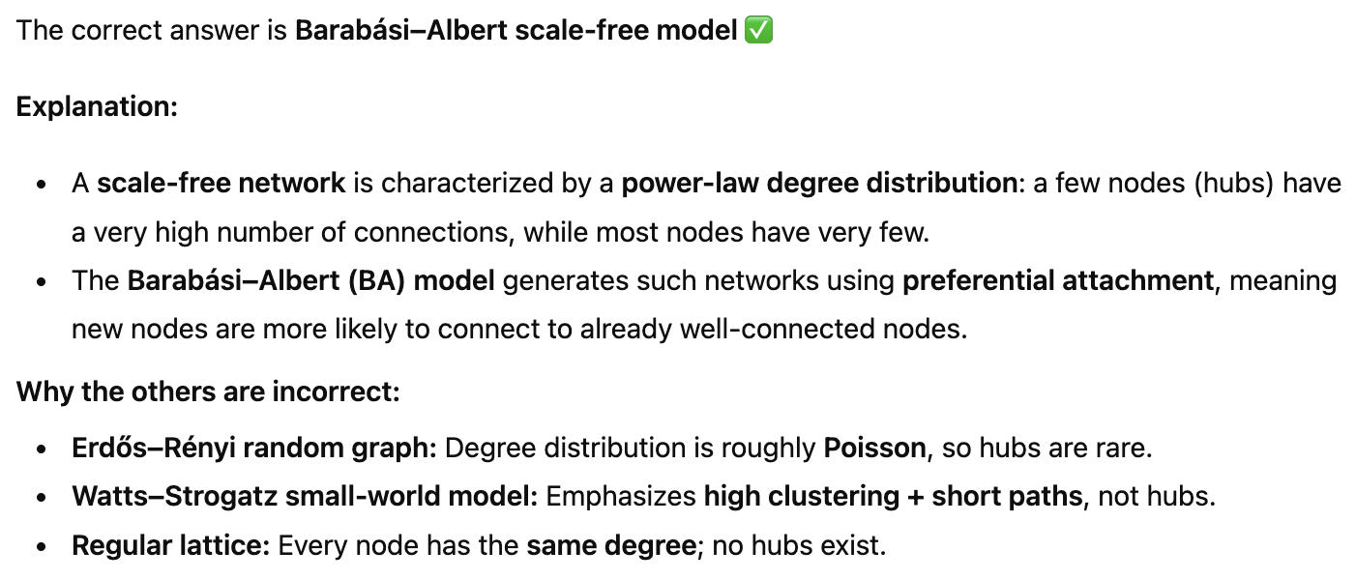
QUESTION 32
Which model best describes a network with many hubs (a few nodes with extremely high degree, many nodes with few edges)?
Erdős–Rényi random graph
Watts–Strogatz small-world model
Barabási–Albert scale-free model
Regular lattice
SOLUTION 32
CORRECT ANSWER 32
c)

Slide 46
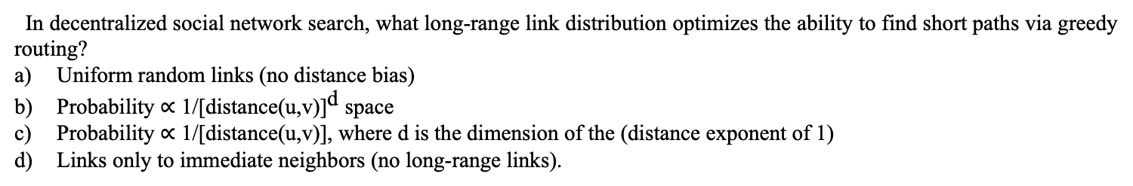
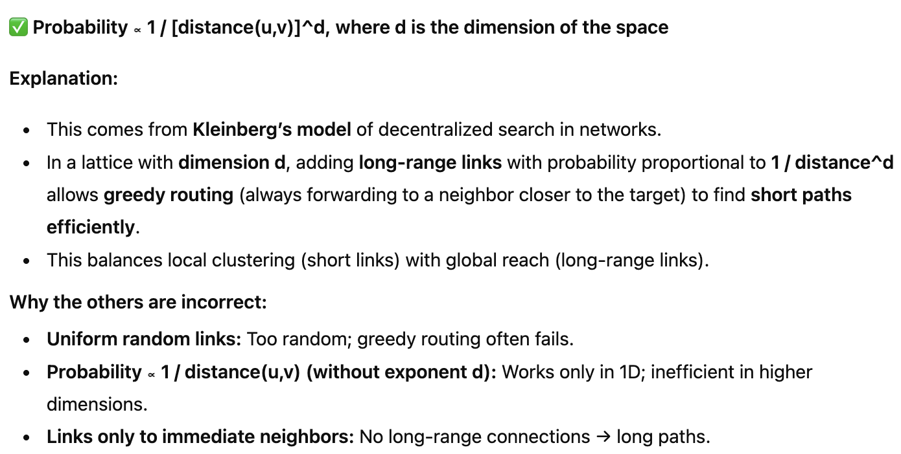
QUESTION 33
SOLUTION 33
CORRECT ANSWER 33
b)

Slide 47
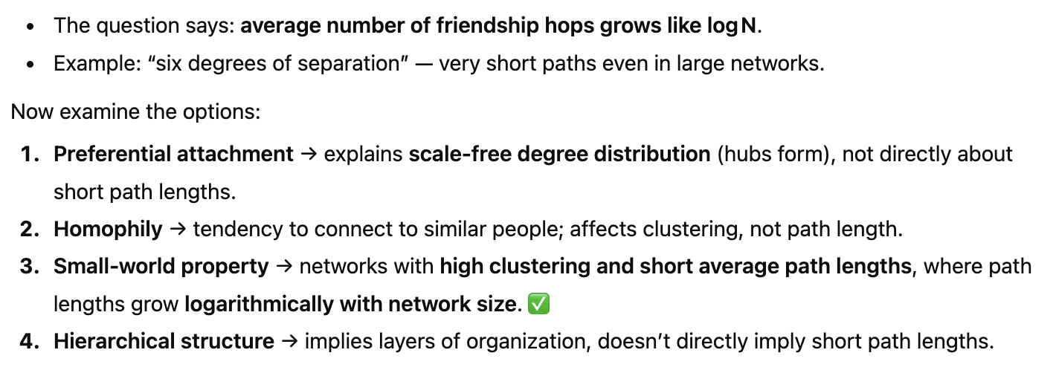
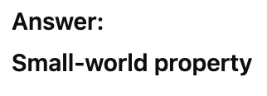
QUESTION 34
Suppose you have a social network of N people, and the average number of “friendship hops” between any two random people grows on the order of log N. This phenomenon (e.g. “six degrees of separation”) is characteristic of what network property?
Preferential attachment
Homophily
Small-world property
Hierarchical structure.
SOLUTION 34
CORRECT ANSWER 34
c)

Slide 48
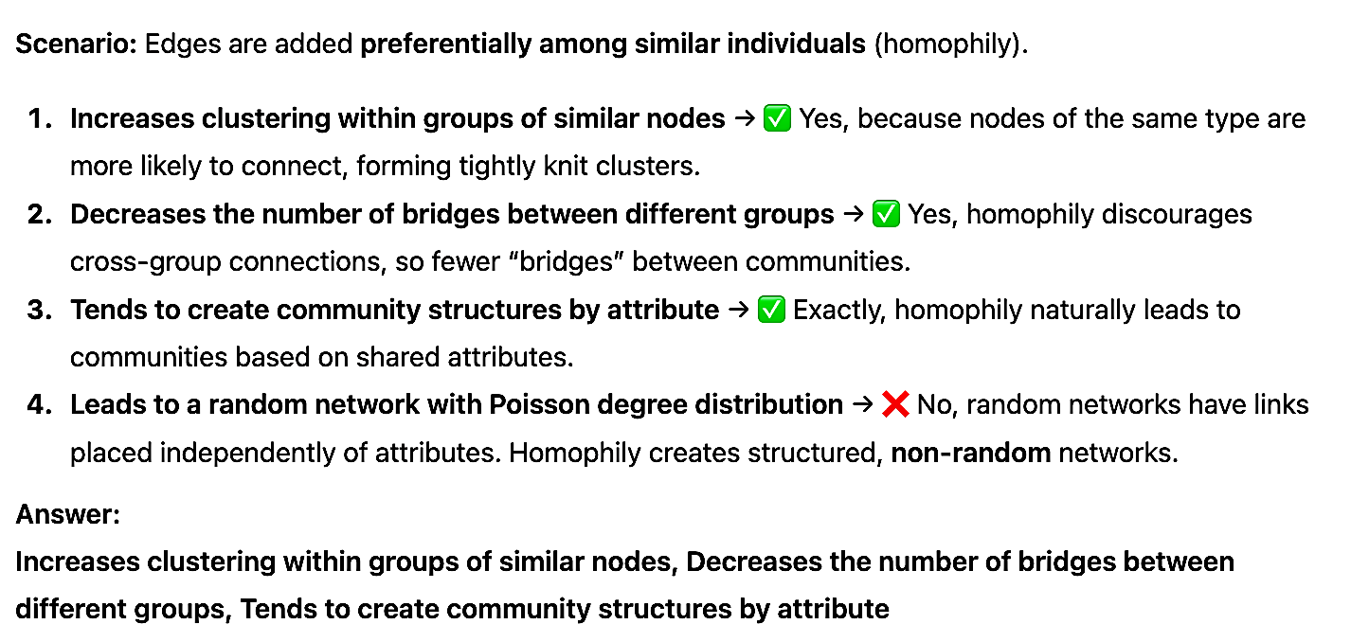
QUESTION 35
You simulate adding edges preferentially among similar individuals (homophily) versus adding random long-range edges (weak ties). Which effects does homophily have on the network? (Choose all that apply.)
Increases clustering within groups of similar nodes.
Decreases the number of bridges between different groups.
Tends to create community structures by attribute.
Leads to a random network with Poisson degree distribution.
SOLUTION 35
CORRECT ANSWER 35
a), b), c)

Slide 49
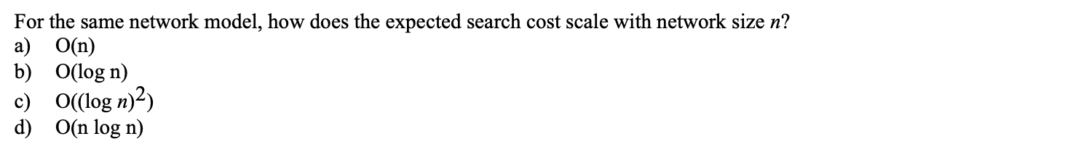
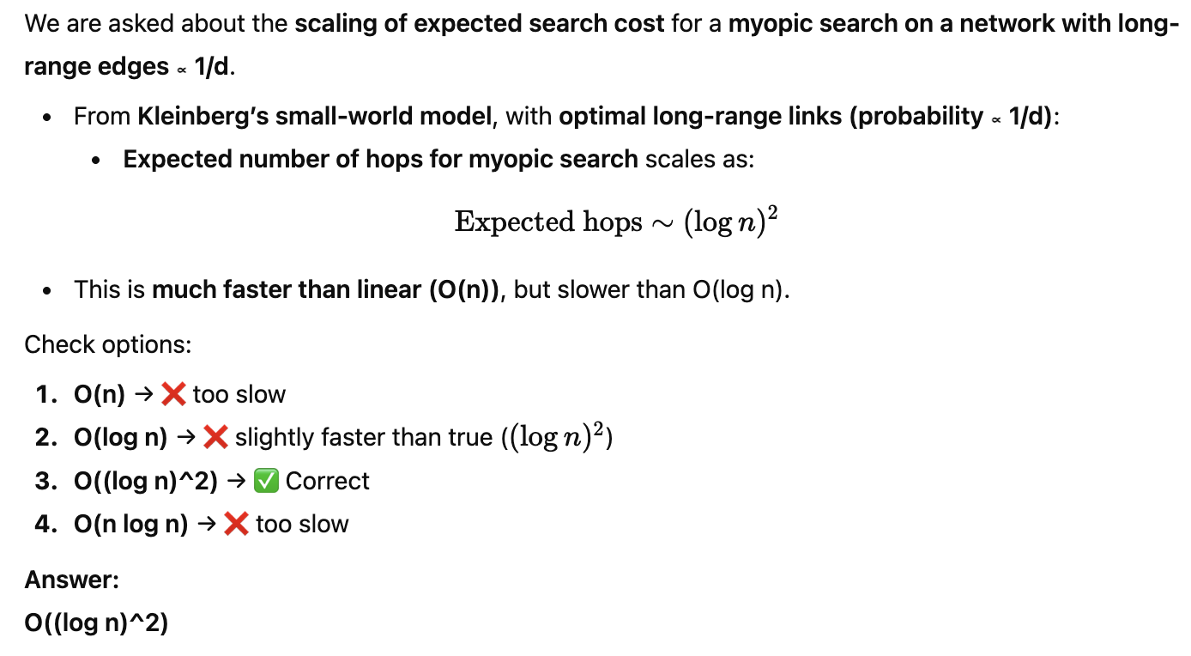
QUESTION 36
SOLUTION 36
CORRECT ANSWER 36
c)

Slide 50


Contact me: https://sites.google.com/view/ayans-agribot/home

